Slide 1

Reactor on Chip (ROC): Simulated Industrial Plant on Raspberry Pi
Cooper Parlee and Alyssa Moody
23 April, 2026

Slide 2
Agenda
Overview
Simulation Environment
Fluid Simulation
Thermal Simulation
Modbus Communication
PLC and Modbus Communication
HMI Integration
PID Construction and Tuning
Avenues for Continued Work

Slide 3
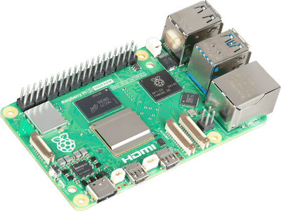
Overview
Automation and Controls Lab
Pro: PLCs and Control Systems
Con: SCADA or HMIs (Industry Standard)
Virtual plant running on Raspberry Pi
Communicate over Modbus
Compatible with other Lab Devices
Framework for Further Projects
Notes:
Scada -> network of devices, controlling and monitoring real time data
HMI (human-machine interface) -> operators use to control systems, how we interact
Solution to this problem...
(Supervisory Control and Data Acquisition)

Slide 4
Simulation Environment
System Broken into 3 Modules
Extensibility
Ease of Programming
Organization
Why?
Fluid Power Simulation
Thermal Simulation
Modbus Communication/Sensor Handling

Slide 5
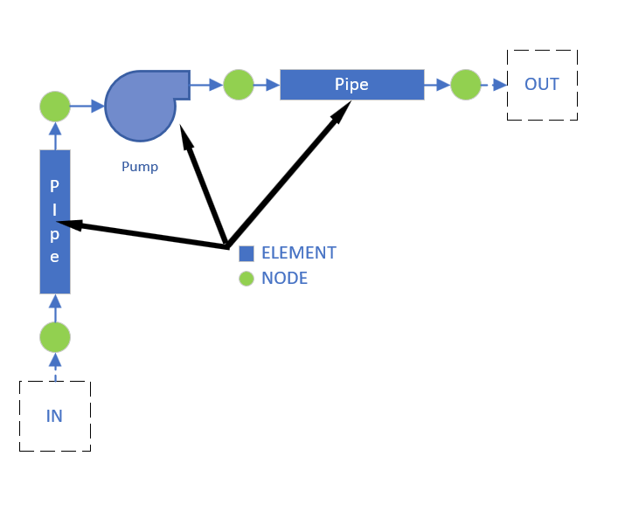
Simulation Environment – Fluid Power
Simulation broken into “elements” and “nodes”
Elements represent physical phenomena
Nodes connect elements
Nodes record fluid data (temperature, pressure, flow)

Slide 6
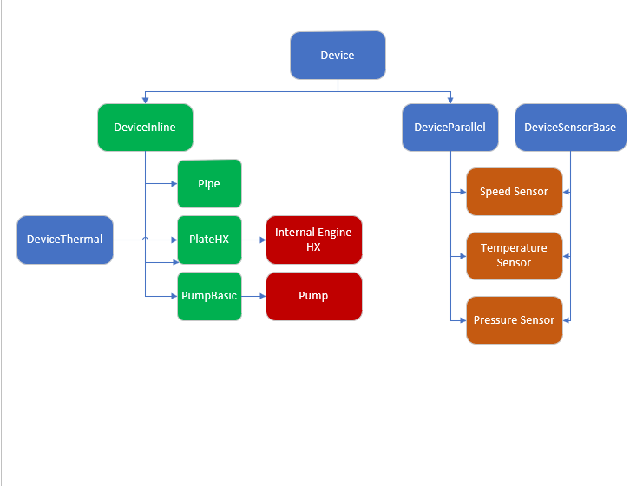
Fluid Power – Elements Polymorphism

Slide 7
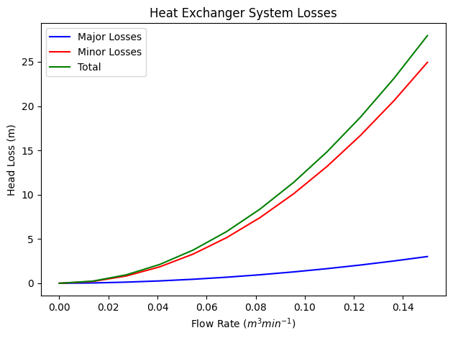


Fluid Power – System Curve
Calculate major and minor losses
$$H_{mj}=f⋅\frac{l}{D}⋅\frac{v^{2}}{2g}$$
$$H_{m}=k∗\frac{v^{2}}{2g}$$

Slide 8
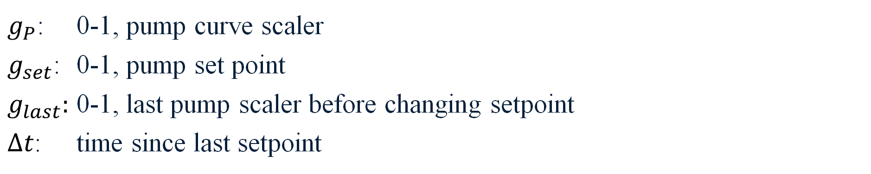
Fluid Power – Dynamic Pumps
Equation pulled from pump curve (head in m, flow in m^3/s)
$$H=−241374⋅q^{2}−2.2726⋅q+19.105$$
Pump ramp-up
Pump variable setpoint (for control with PLCs)
$$g_{P} = g_{set}+\left(g_{last}−g_{set} \right)⋅e^{−\frac{Δt}{τ}}$$
$g_{P}$: 0-1, pump curve scaler
$g_{set}$: 0-1, pump set point
$g_{last}:$ 0-1, last pump scaler before changing setpoint
$Δt$: time since last setpoint

Slide 9
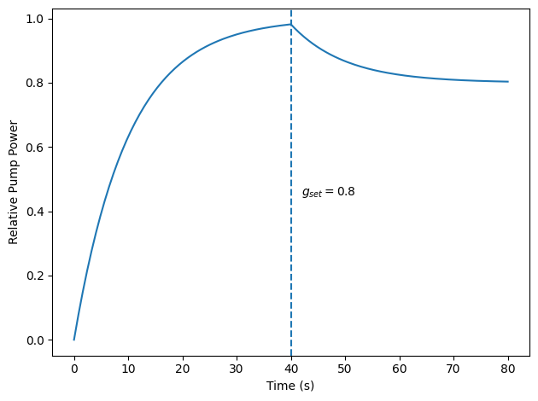
Fluid Power – Dynamic Pumps

Slide 10
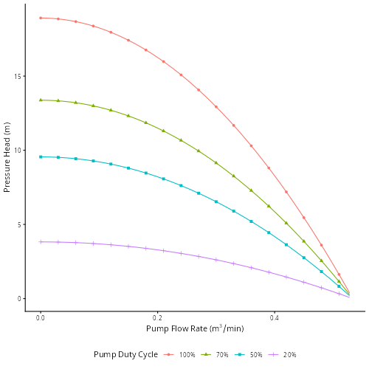
Fluid Power – Dynamic Pumps

Slide 11
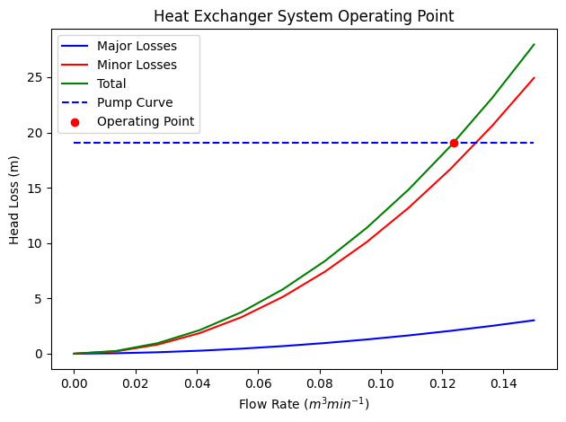
Fluid Power – Operating Point
Scipy Brentq (Brent’s Method)
$$f\left(\dot{V}\right)−H_{mi}\left(\dot{V}\right) − H_{mj}\left(\dot{V}\right)$$

Slide 12
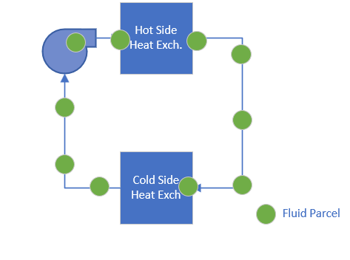
Thermal Mass Transport
Discrete Thermal Mass Model
Fluid modelled as discrete masses “parcels”
Total mass from volume
Individual mass from n parcels
Evenly distributed throughout model
Move via velocity calculated from flow
Heat transfer occurs in DeviceThermal objects

Slide 13
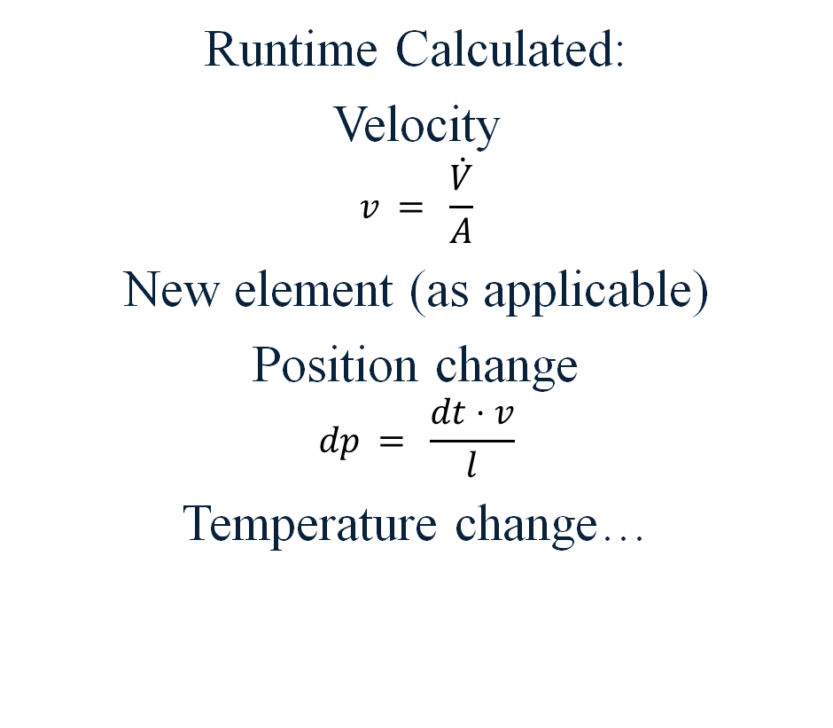
Thermal Mass Transport - Parcels
Known information:
Volume, mass
Element
Position within element
Temperature
Runtime Calculated:
Velocity
$$v = \frac{\dot{V}}{A}$$
New element (as applicable)
Position change
$$dp = \frac{dt⋅v}{l}$$
Temperature change…

Slide 14


Thermal Mass Transport - Thermals
Thermal model stores list of parcels within specific elements (i.e. heat exchangers)
getHeatFlow calculates heat flow for any given time difference between parcels and ThermalDevice object using:
$$Q = \frac{ΔT ⋅A ⋅Δt}{R_{T}}$$
$$r_{cond}=\frac{l_{c}}{k⋅A}$$
$$r_{conv}=\frac{1}{hA}$$
Notes:
k = 50
h = 3000 explicitly so I don’t need to calc Nussalt and Prandalt numbers

Slide 15
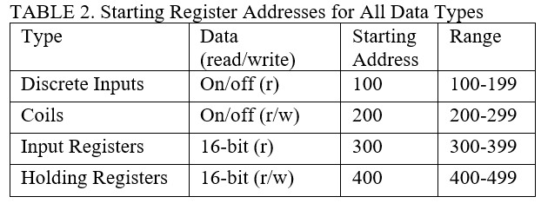
Modbus
DeviceParallel class + DeviceSensor sends data to ir addresses
Holding registers changed by PLCs
Holding register callback

Slide 16
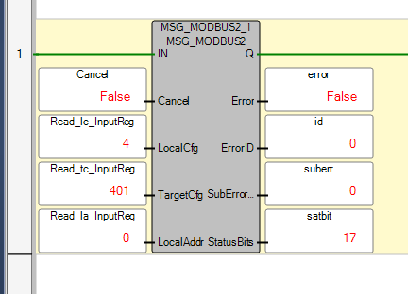
Establishing PLC and Modbus Communication
Software Tool:
Connected Components Workbench (Rockwell Automation)
Instruction Blocks Used:
MSGMODBUS2
Read/Write
Key Parameters for Modbus:
IP Address: 192.168.10.120
Port: 5020
Notes:
PLC = Modbus Client
Talk about block input/output next slide

Slide 17
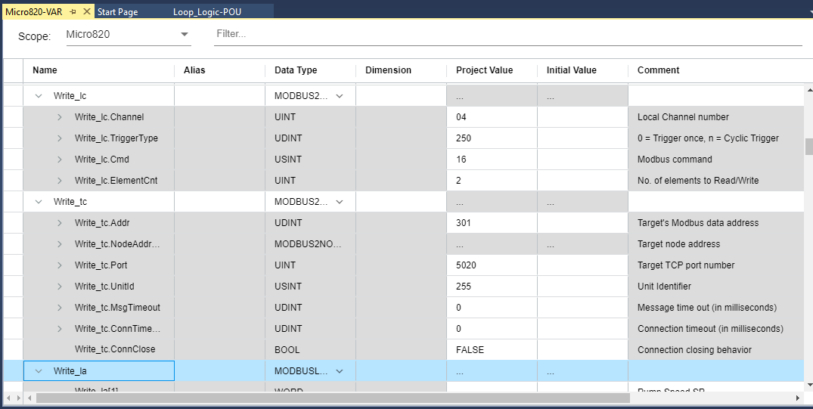
PLC and Modbus Communication: Writing Registers
Notes:
Write MSG block - Global Variable
2 sections (local and target Config)
LC:
Command (3 Read Hold, 4 Read Input, 6 write one, 16, write multi (holding))
# of elements to read/write
TC:
Modbus Addressing - tells modbus where that info need to go
Indexing Problem -> need to add one to write
IP Address Modbus

Slide 18
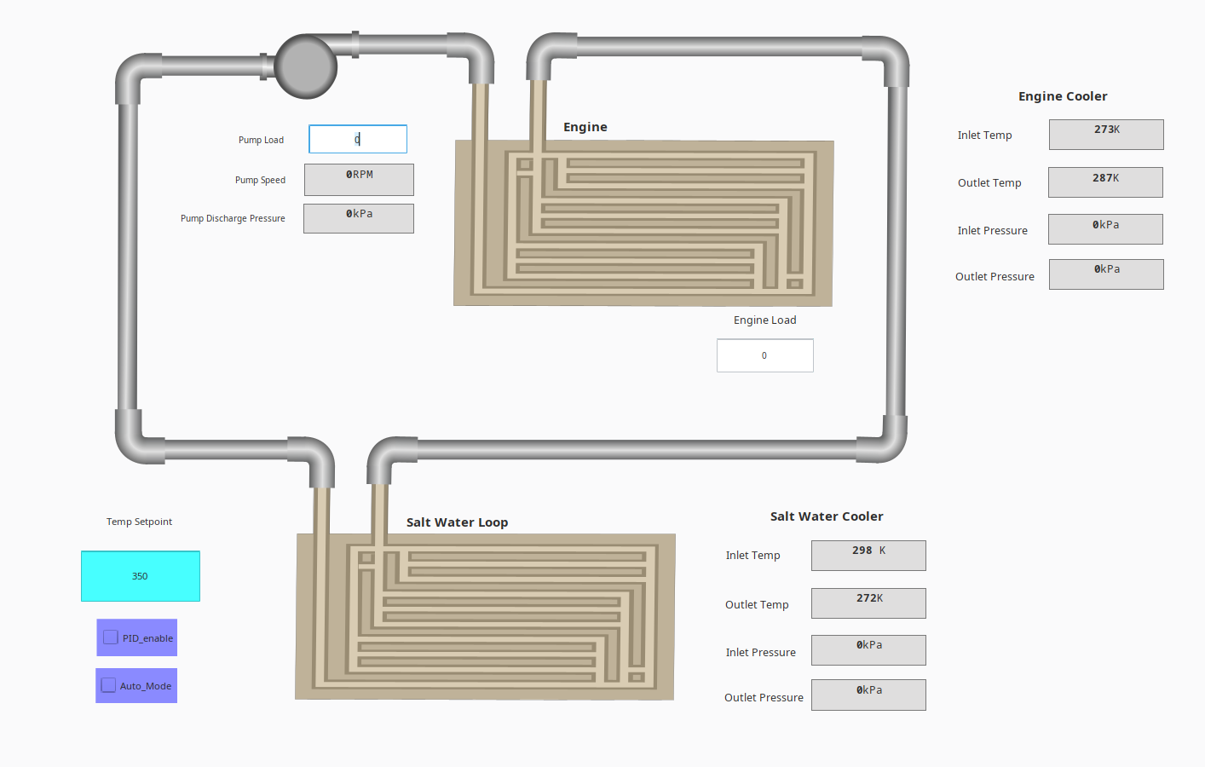
HMI Integration:
Software Tool:
Ignition Designer Launcher
Inputs
Pump Load
Engine Load
PID Enable
Auto Mode
Setpoint

Slide 19
HMI Integration:
Outputs
Engine
Inlet/Outlet Temperature
Inlet/Outlet Pressure
Saltwater Cooler
Inlet/Outlet Temperature
Inlet/Outlet Pressure
Pump Speed
Pump Discharge Pressure

Slide 20
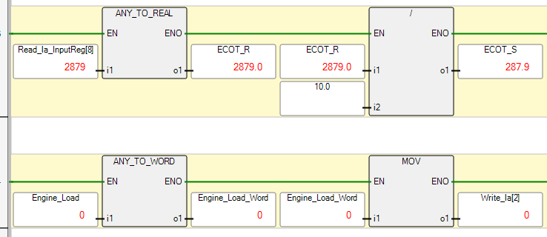
HMI Integration: Data Manipulation
Data Types
Integer (INT)
Real (REAL)
Word (WORD)
Math Function Blocks
Add/Subtract
Division
Move Block
Relocates Data
Notes:
Can’t get to that point w/o data manipulation
Points come in as INT data type
Need to change the data type
Scale raw value
Change data type again
Move data to MSG block to send to Pi Modbus
Int 16 bit
Word 32 bit
Real (32 or 64 bit) floating point

Slide 21
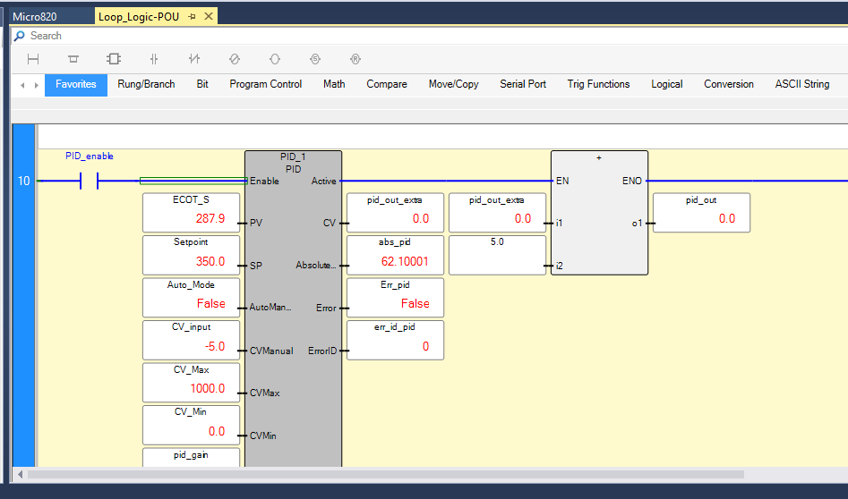
PID Construction and Tuning
Inputs:
PID Enable (BOOL)
Process Variable (REAL)
Setpoint (REAL)
Auto Mode (BOOL)
CV Input (REAL)
PID Gains
Control (BOOL)
Outputs:
Control Variable (REAL)
Absolute Error (REAL)
Notes:
- Proportional Integral Derivative (calcs error using a setpoint which then applies it to output)
- More realistic model (relation to real world)
Manual vs Auto Mode
Enable on both modes
PV (control to)(engine temp)
Temp value
Toggle
Pump load
Very important -> reverse process direct control -> wont work if wrong

Slide 22
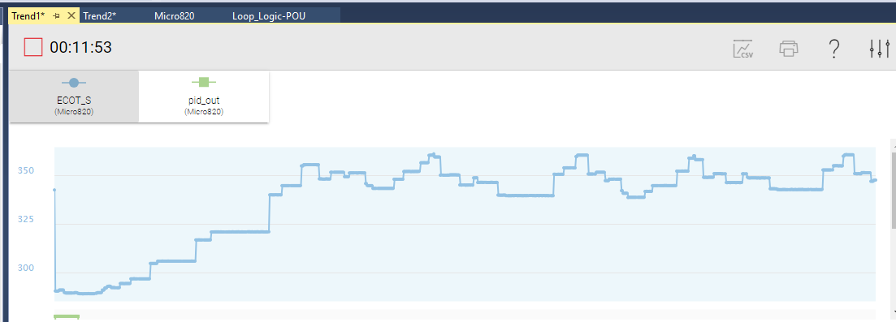
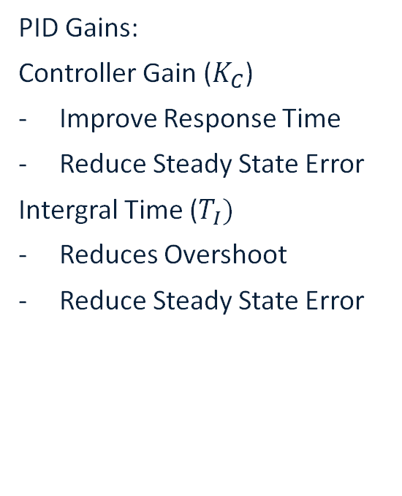
PID Construction and Tuning
PID Gains:
Controller Gain ($K_{C}$)
Improve Response Time
Reduce Steady State Error
Intergral Time ($T_{I})$
Reduces Overshoot
Reduce Steady State Error
Process Variable (Engine Outlet Temperature)
Notes:
Three parameters (deriv time = 0)
Engine load = hard tuning -> nonlinear
Tune @ EL = 100% -> most linear section when tested
Found experimental w/ bump test
Change Setpoint to See how system respond to change
Need more tuning -> real system = bad, this application = ok
Overshoot and oscillation

Slide 23
Future Work
Branched flow
Valves
Multi-loop design (i.e. HT loop and saltwater cooling loop)
Spawning multiple clones of plant process threads

Slide 24

Questions?
For codebase access:

Slide 25
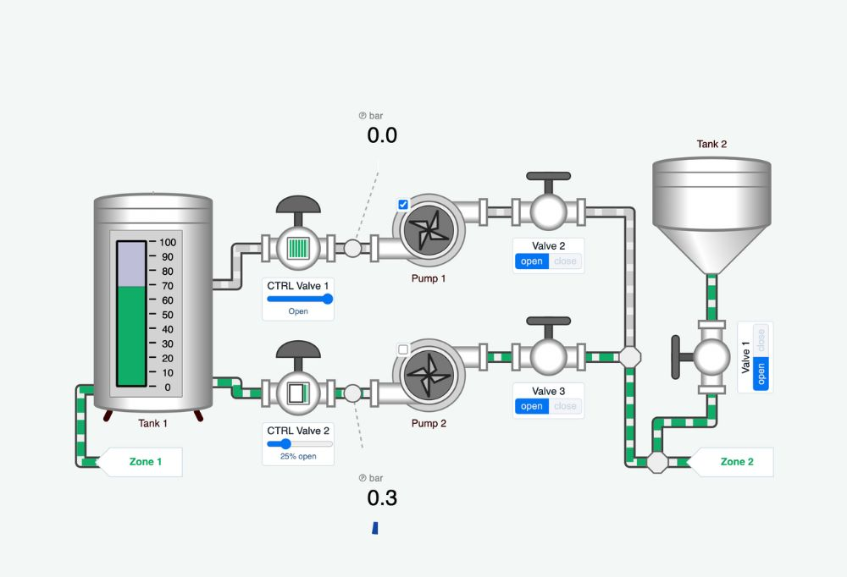

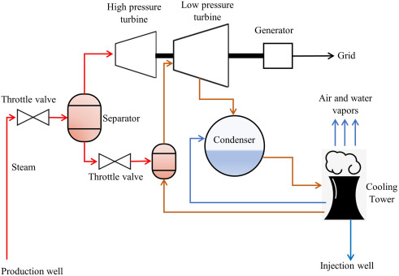

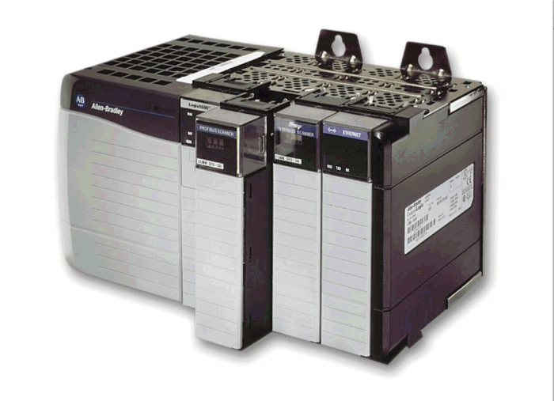
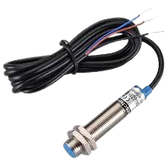
Overview – Flow Diagram
“Pump”
“Sensor”
“Valve” etc.

Slide 26
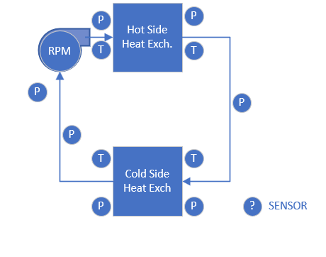
Thermal Mass Transport
Decision Making: How to model temperatures? Options:
Thermal Network Model
Heat transfers functionally with flow from element to element
Does not reflect transport time easily
Heat flow “queue”
Heat exchanger flux:
$$q=ṁc_{p}ΔT$$
$$q = UAΔT_{LM}$$

Slide 27
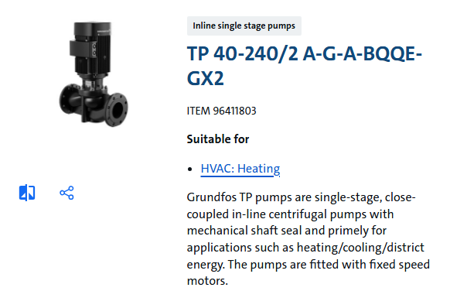
Fluid Power – Dynamic Pumps
“Variable” output pump chosen for system control

Slide 28



Fluid Power – Head Loss Functions
Inline devices have major and/or minor losses:
Compute major losses (only DevicePipe): function of flow rate
$$v=\frac{\dot{V}}{A}$$
$$R_{e}=\frac{ρvD}{μ}$$
$$f = \frac{0.25}{{\left[\log\left(\frac{ε}{3.7D}+\frac{5.74}{Re^{0.9}}\right)\right]}^{2}}$$

Slide 29



Fluid Power – Head Loss Functions
Finally:
$$H_{mj}=f⋅\frac{l}{D}⋅\frac{v^{2}}{2g}$$
Minor losses:
$$H_{m}=k∗\frac{v^{2}}{2g}$$
Total losses are computed for whole loop as
$$H = \sum_{i=0}^{n}{H_{i}\left(\dot{V}\right)}$$

Slide 30
PID Offset
Increase in Engine Outlet Temperature
Decrease in Pump speed
Pump Off:
Pump Speed = 0 RPM
Engine Outlet Temp = 273 K
The engine cannot build heat unless the pump is running
Notes:
PID thinks it needs to build heat -> can't produce (-) RPM
Apply offset
Allows pump always run when in auto -> allows the PID to do its job

Slide 31
Model Shortcomings
Static convective heat transfer model
Mass not distributed by volume, instead by length
Pump curve scales only pressure rather than flow
Heat only transfers in heat exchangers (not pipes or pumps)
Can’t handle parallel flow or non-looped flow
Isothermal sink

